Slide 1
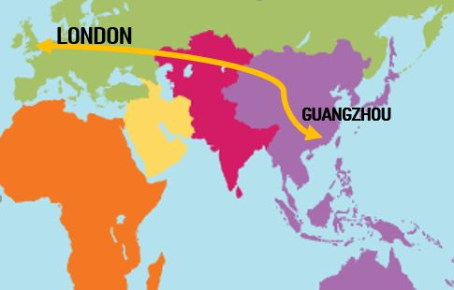
Covina
The sharing cultural experiences platform

Slide 2
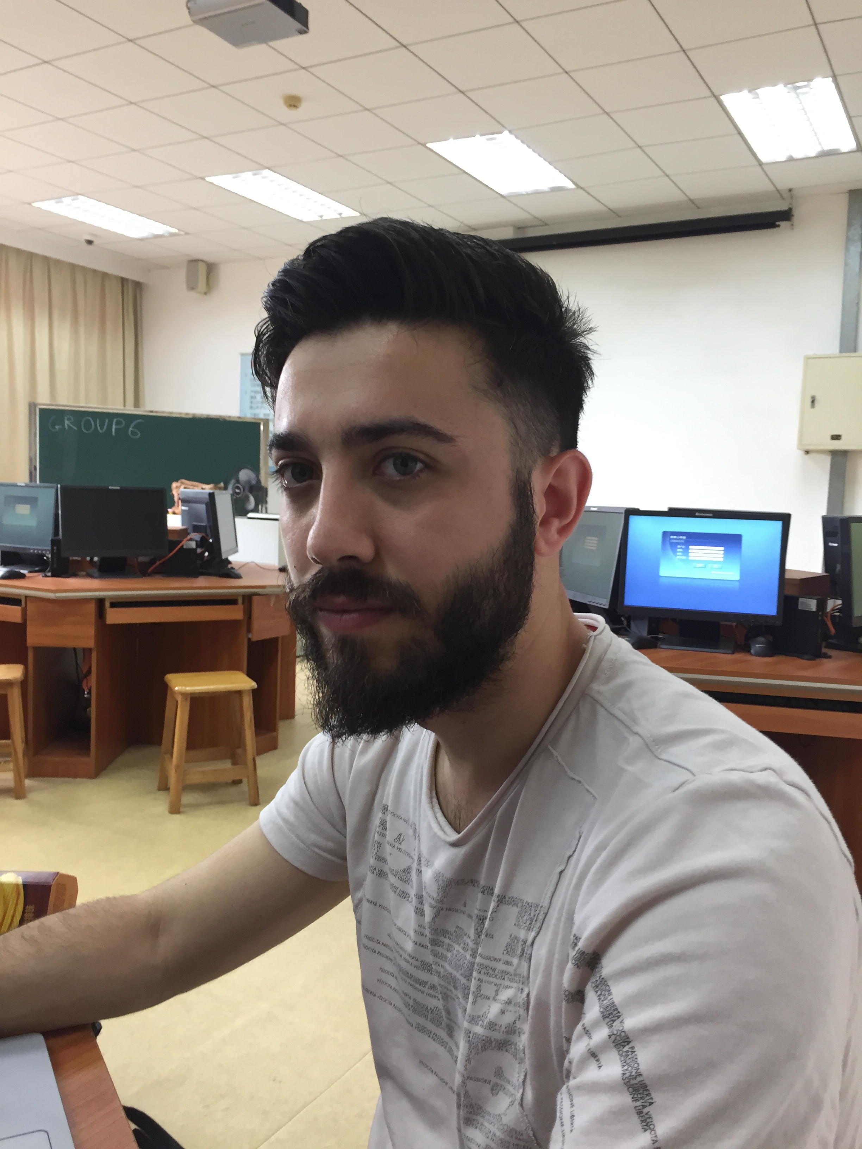
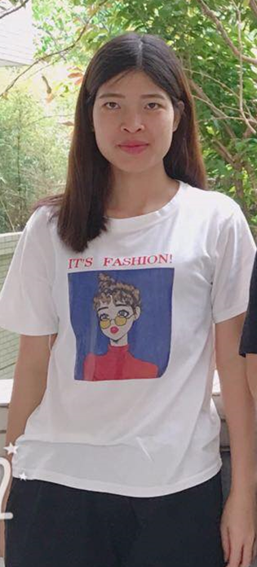
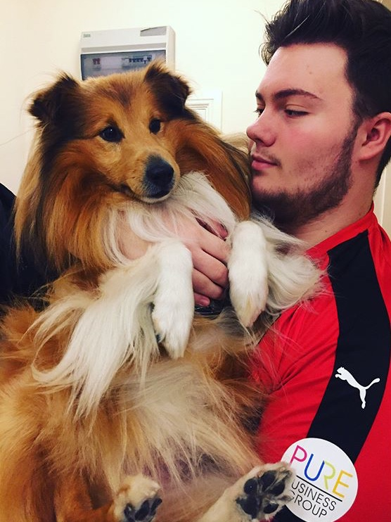

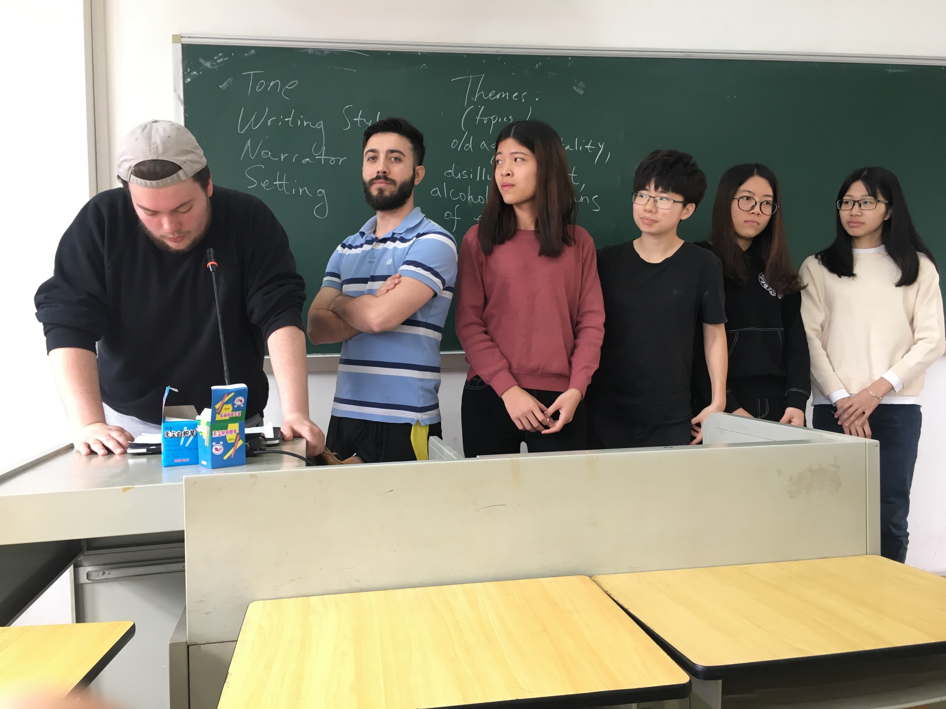

Meet the team
Tony
Wan
Theodora
Euan
Niki
Miaorong

Slide 3
Ideas
Our group project was orientated around the topic of Artificial Intelligence and/or Machine Learning to enhance the culture exchange between the UK and China, which is obviously an important subject to work on.
Initial ideas:
A phone application
A website

Slide 4


Option 1 – Phone Application
As a group our first idea was to come up with as many ideas as we could think of which would inherit some kind of artificial intelligence and/or machine learning.
The first solidified idea we agreed on was to create and develop a mobile application which end users would be able to download from their respective application store (android – GooglePlay) (Iphone – AppStore).

Slide 5
Option 2 – Website
For our second idea we came up with designing a website using Javascript, HTML, CSS etc. Which would supply users with a more dynamic way of accessing our product. We came up with this idea specifically because of the ease of access for end users.
For example, instead of users having to download our application on their mobile devices which obviously requires their time and resources to download the software, we came up with the idea of a website with different page forms that would give the same functionality as the phone application.

Slide 6
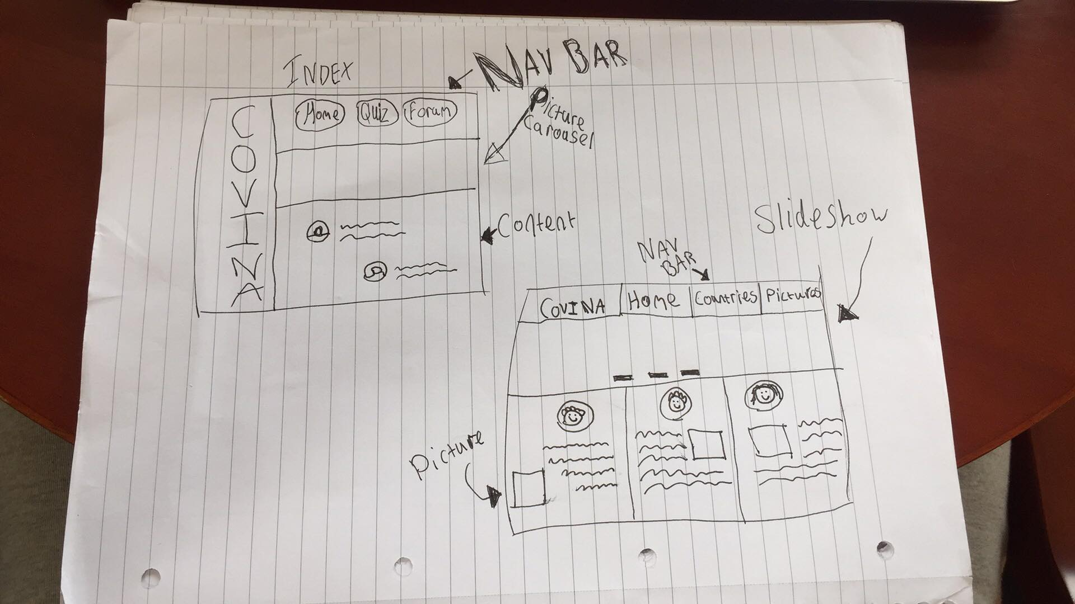
Our decision – Interactive website
First sketches!
After much deliberation about which options we all preferred, we decided on going ahead with the website idea.
The first part of development included some sketches of different website designs and also layout designs etc.

Slide 7
CONTENT
One of t he most important part of the project was discussing and deciding what content we wanted to implement onto the website.
WHAT WE AGREED ON:
4 FORMS
HOME (1)
QUIZ (2) – AI/ML
FORUM/PICTURE POSTING (3)
LIVE CHAT ROOM FROM QUIZ RESULTS (4)

Slide 8
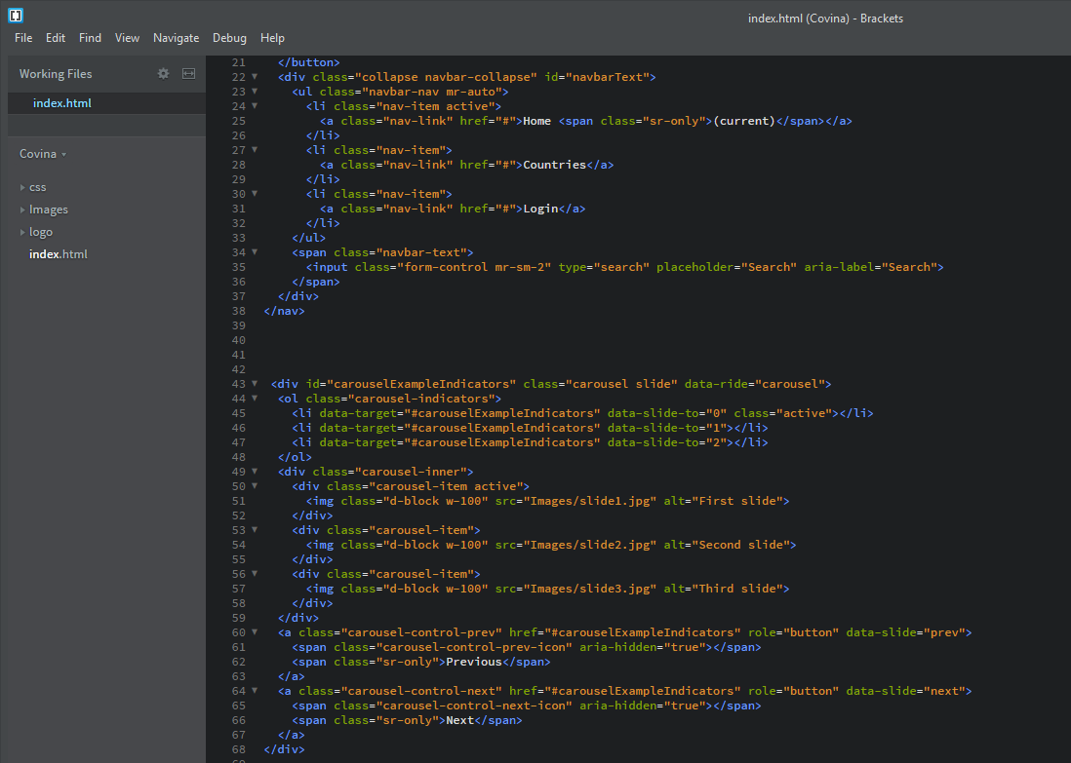
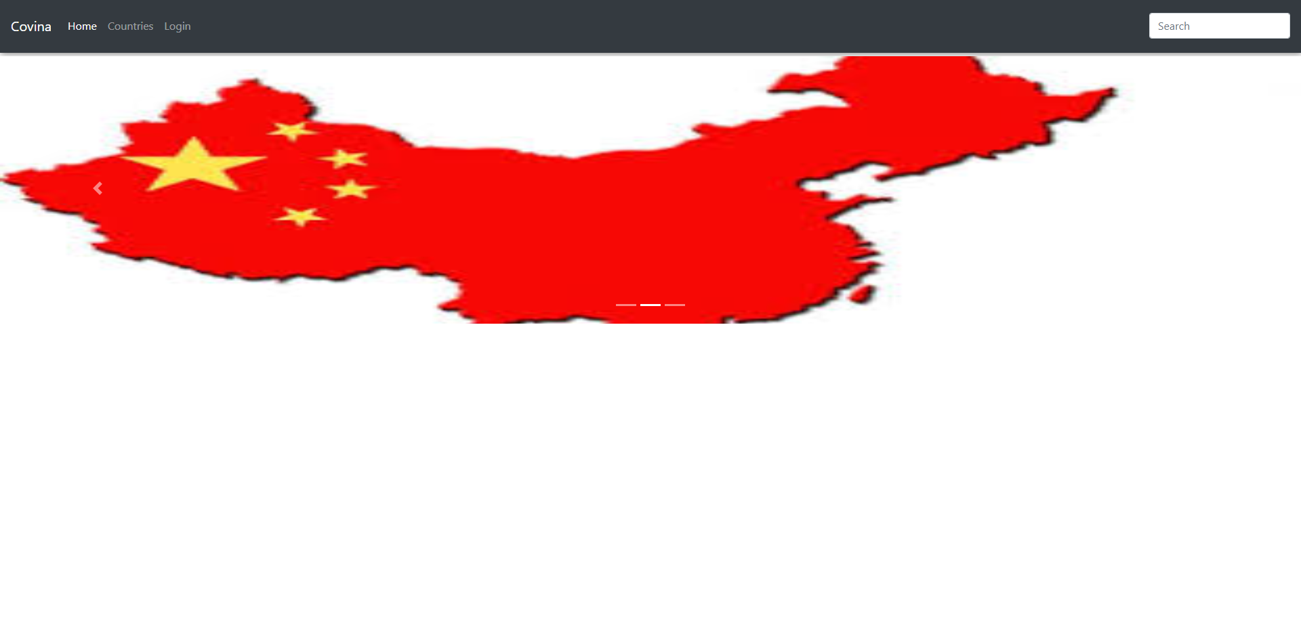
Development
Here were our first moments of the development
Still a long way to go
Functionality was the main goal
Pictures just used as an example
Navigation bar
Buttons
Carousel

Slide 9
Artificial intelligence/machine learning
To incorporate artificial intelligence and machine learning into our project we decided that the best way to incorporate this was to create a quiz which when all questions answered and processing has been completed, the AI computes a randomly generated code which is unique to how you answered the questionnaire. The AI then trawls through our database to find someone in the opposite country which seem most compatible(China/England) and then to finally pair the two users up.
After the user receives their code, the next step is to go to the chatroom and input the unique code which the AI will then connect you with your partner!
Get chatting!

Slide 11
Thankyou
Q & A

